Slide 1

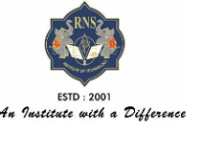

SALON BOOKING APP
RNS INSTITUTE OF TECHNOLOGY
BENGALURU - 98
DEPARTMENT OF INFORMATION SCIENCE & ENGINEERING
Presentation on Internship
NAME:Neha B S
USN: 1RN18IS068
ENMAZ Engineering Services Pvt. Ltd.
Internal Guide
Ms. Sowmya S K
Asst. Prof, Dept of ISE, RNSIT
External Guide
Mr. Akshay D R
Enmaz

Slide 2
AGENDA
About the Company
Abstract
Introduction
Requirements
System Design
Detailed Design
Implementation
Testing
Conclusion and Future Enhancement
References
Q & A

Slide 3
ABOUT THE COMPANY
Enmaz is the IT services company registered under Govt. of India, Ministry of Micro, Small & Medium Enterprises.
Enmaz has a simple yet robust solution that helps any Industry/Factory digtise their workfloor in no time.
The products offered will help in remote monitoring ,controlling and also analysing and machine parameter or process.
Their Mission is to empower their customers with necessary knowledge, skills and resources for them to succeed in their endeavors.

Slide 4
ABSTRACT
Flutter is an open source cross-platform mobile application development SDK created by Google.
Dart is a programming language designed for client development such as for the web and mobile apps
Dart is ab object-oriented,class-based,garbage-collected language with c-style syntax.
Dart can compile to either native code or javascript.
Salon booking app is a mobile-based salon app with appointment scheduling functionality.
It Connects clients ,salons ,and stylists in an online community allowing users to browse salons and stylists ,book or cancel appointments.

Slide 5
INTRODUCTION
This is a real time project, where we have designed a software for the customers to book their appointments for saloon for the required time in online.
General features of online salon booking system are Appointment management, point of sales and billing system, marketing campaigns, Reporting, staff management, customer Management etc.
The software created is fast, reliable and secure

Slide 6
REQUIREMENTS
Software Requirement
Hardware Requirement
Name of the components | Specification
Operating System | Windows 10
Language | Dart
Software development kit | Flutter,Visual studio code
Name of the components | Specification
Processor | 10 th Gen Core i7 Processor
RAM | 8 GB
Hard Disk | 512 GB SSD
Speed | 2.33 Ghz

Slide 7
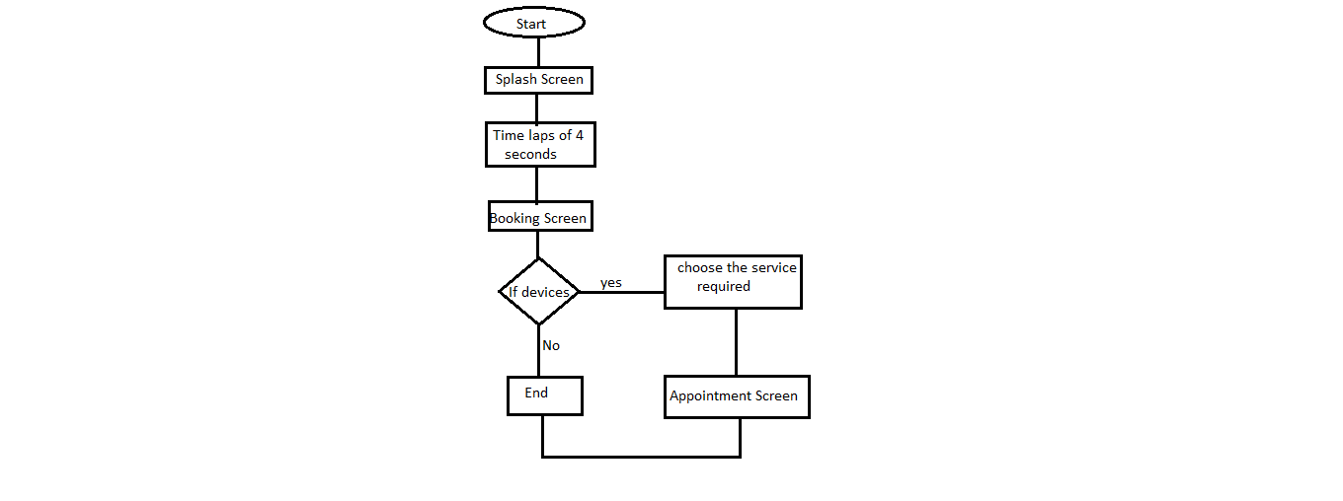
SYSTEM DESIGN
CURRENT DESIGN:
Fig. System Architecture

Slide 8
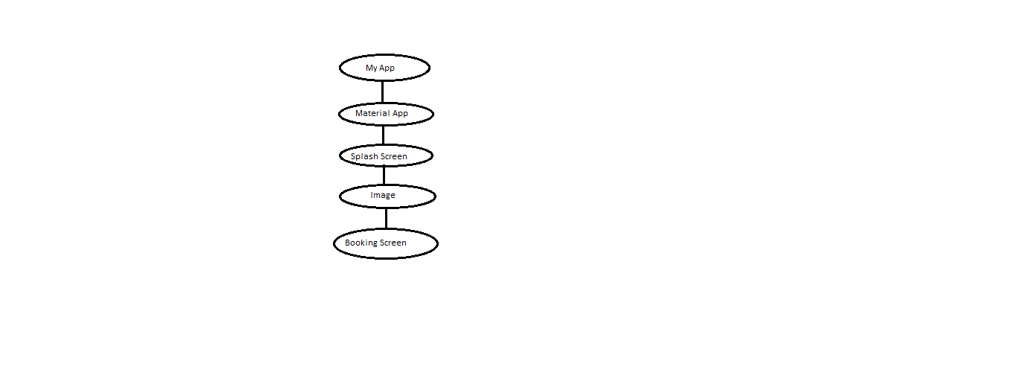
DETAILED DESIGN
WIDGET TREE FOR SPLASH SCREEN

Slide 9
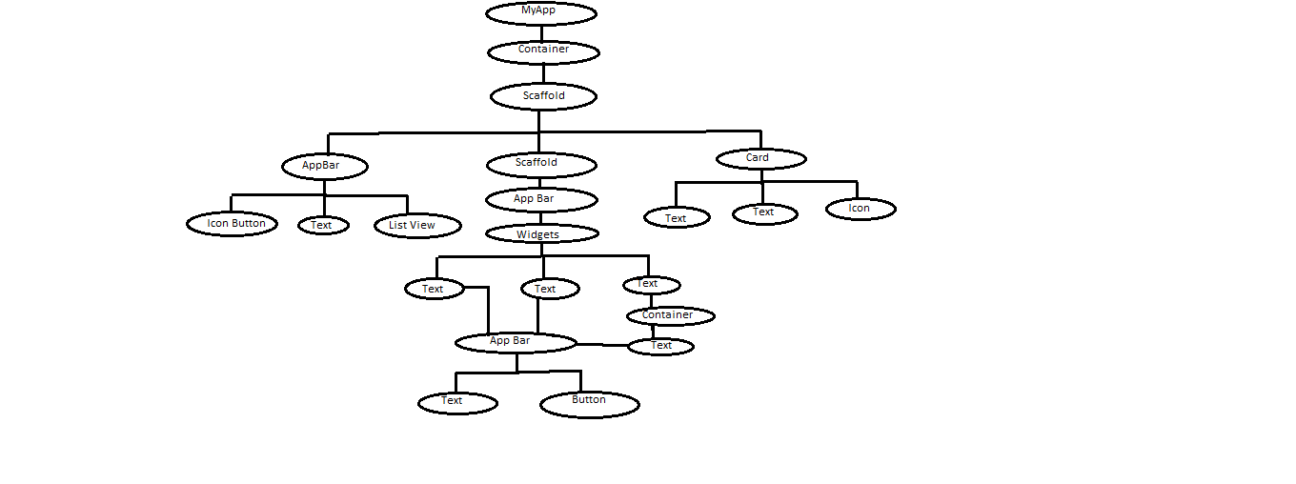
DETAILED DESIGN
WIDGET TREE FOR BOOKING SCREEN:

Slide 10
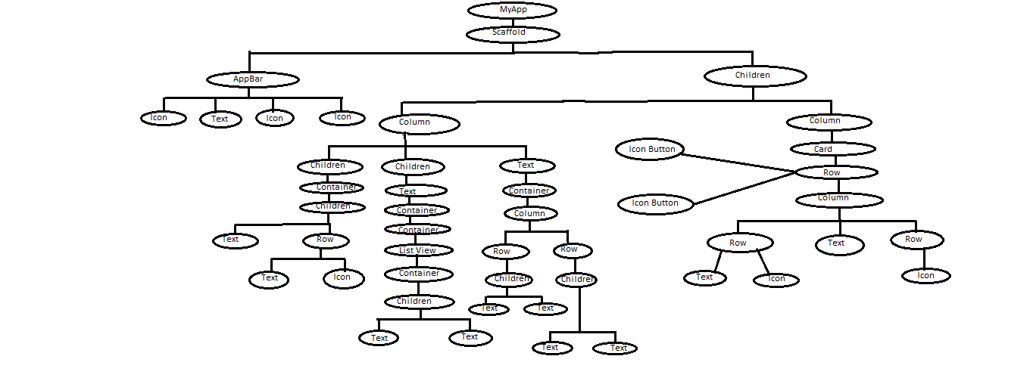
DETAILED DESIGN
WIDGET TREE FOR
APPOINTMENT SCREEN:

Slide 11
IMPLEMENTATION
NAVIGATION CODE:
routes: {
'/bookingScreen': (context) => BookingScreen(),
'/mappage': (context) => Mappage(),
'/appointmentScreen': (context) => AppointmentScreen(),
},
home: SplashScreen(),
debugShowCheckedModeBanner: false,
),

Slide 12
IMPLEMENTATION
Booking code: This snippet will book the appointment
Image.network( 'https://thumbs.dreamstime.com/b/blue-sky-clouds-abstract-art-background-watercolor-digital-artwork-136551201.jpg', fit: BoxFit.fitHeight, ), Scaffold( endDrawer: Drawer(), appBar: AppBar( title: Row( mainAxisAlignment: MainAxisAlignment.spaceBetween, children: <Widget>[ SizedBox(width: 50,), Text( "Booking", style: Theme.of(context).textTheme.headline6, ), IconButton( icon: Icon(Icons.notifications), onPressed: () {}, ), ], ),

Slide 13
IMPLEMENTATION
Appointment code:-
Widget build(BuildContext context) { return Scaffold( backgroundColor: Colors.white, appBar: AppBar( elevation: 0, backgroundColor: Colors.orangeAccent[100], leading: IconButton( icon: Icon( Icons.arrow_back, ), onPressed: () => Navigator.of(context).pop(), ), title: Text("Appointment"), centerTitle: true, actions: <Widget>[ IconButton( icon: Icon( Icons.notifications, ), onPressed: () {}, ),

Slide 14
TESTING
Testing is a process of executing a program with the interest of finding an error. A good test is one that has high probability of finding the yet undiscovered error
Levels of Testing
Unit testing is a level of software testing where individual units/ components of a software are tested.
Integration testing is also taken as integration and testing this is the major testing process where parts of the program is working fine or not.
System testing is defined as testing of a complete and fully integrated software product.
Validation testing provides final assurance that software meets all functional, behavioral and performance requirements.
After preparing test data, the system under study is tested using the test data.
User acceptance testing is a type of testing performed by the end user or the client to verify/accept the software application to the production environment.

Slide 15
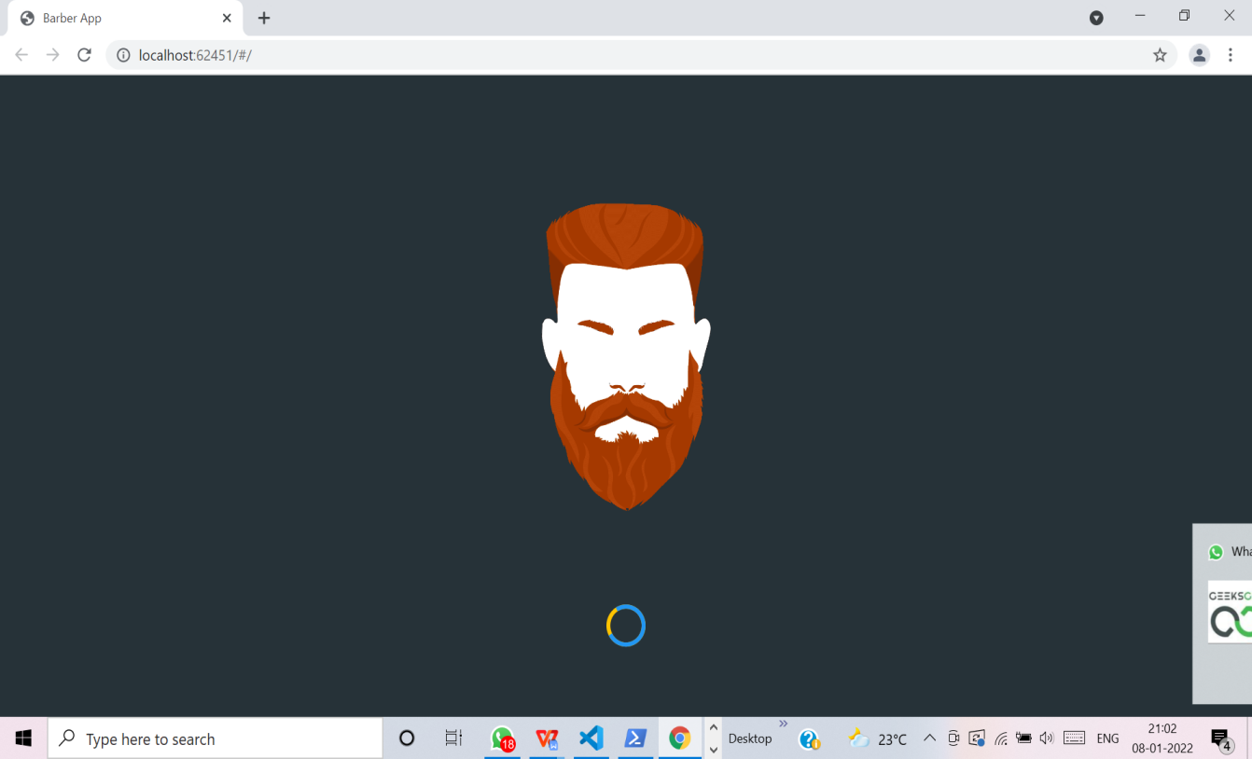
RESULTS
1.Splash Screen:

Slide 16
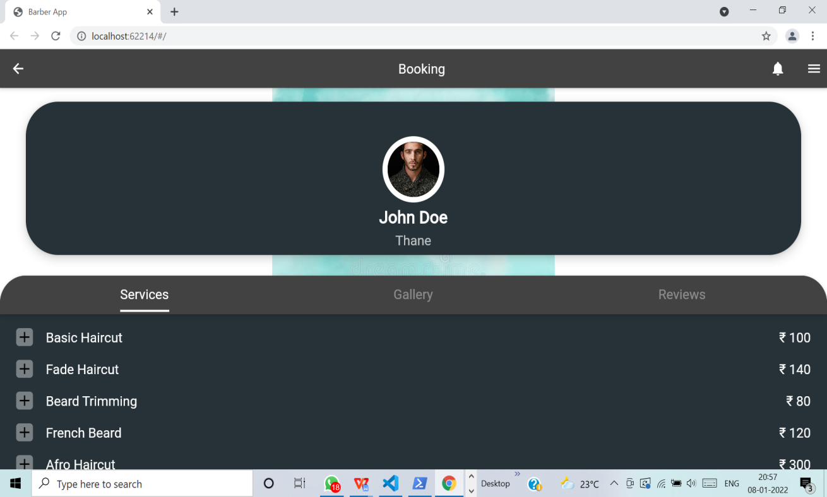
RESULTS
2.Booking Screen:

Slide 17
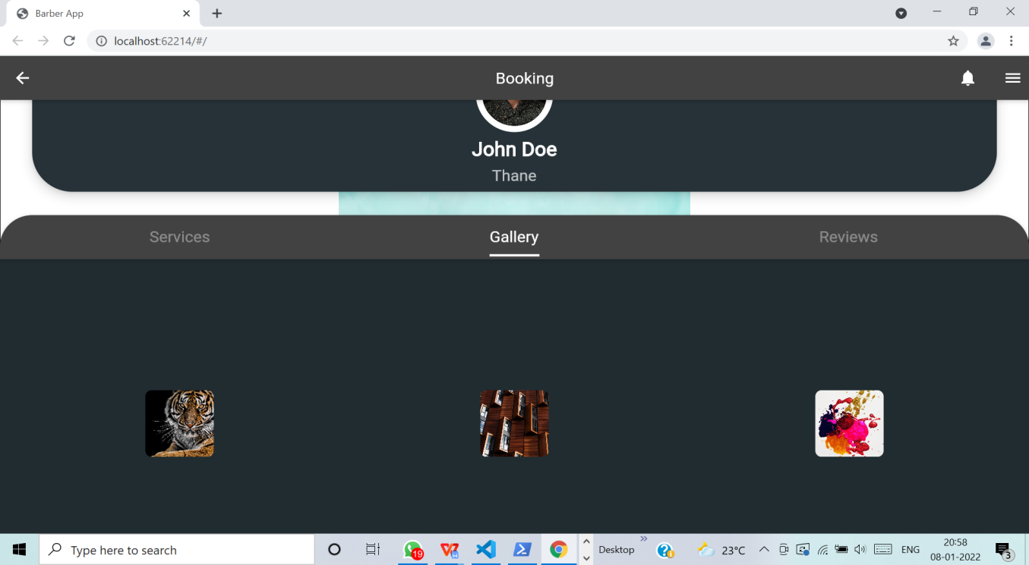
RESULTS
3.Booking Screen with gallery:

Slide 18
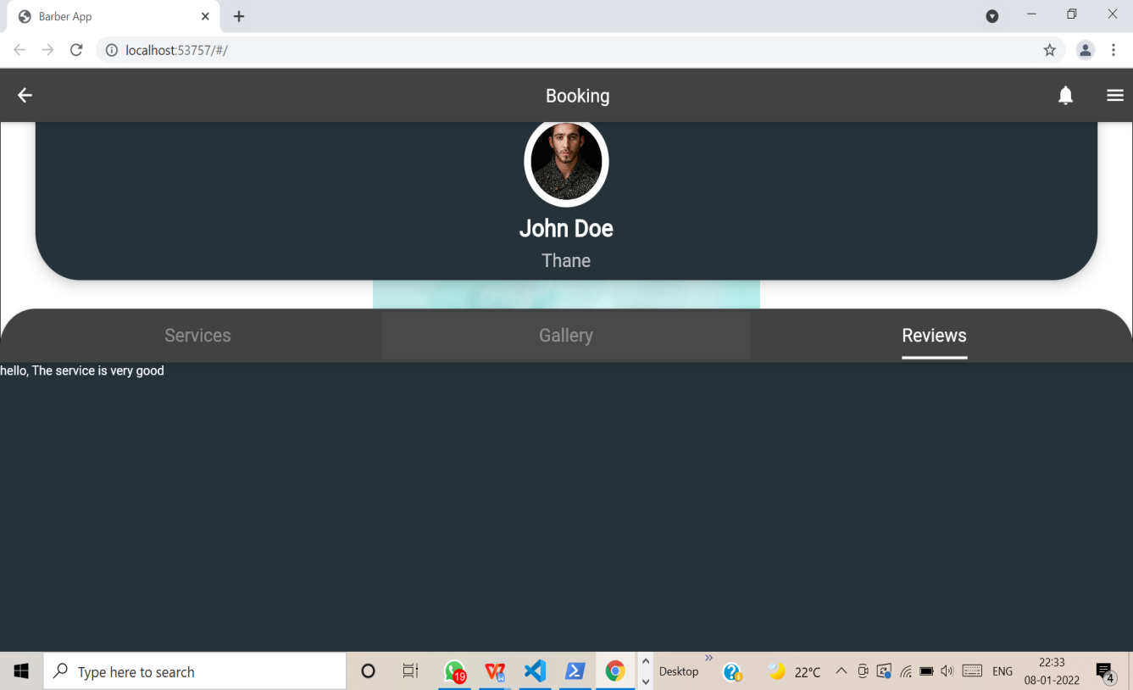
RESULTS
Booking screen with feedback

Slide 19
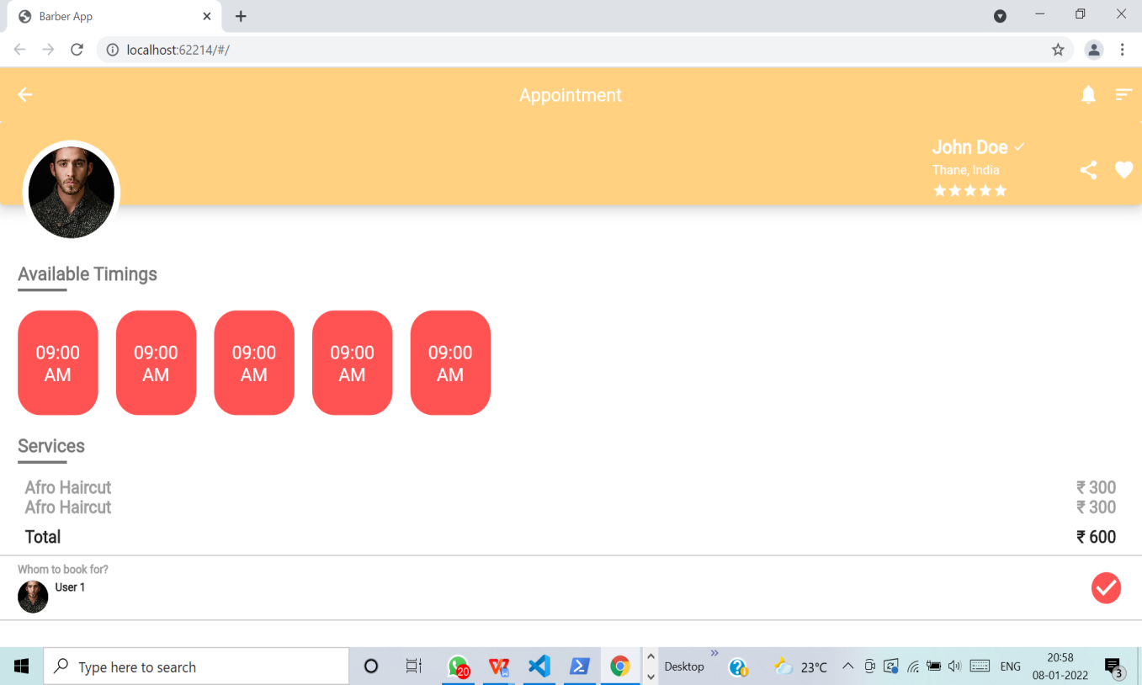
RESULTS
Appointment Screen

Slide 20
CONCLUSION AND FUTURE ENHANCEMENT
Online booking is a faster, easier way for clients as well as salon businesses to take work and manage it according to their availability. This development application mainly focuses on UI
Login and sign-up page can be implemented in order to secure the application.
Secured payment system with various payment methods.
Implementing the email or message service as the remainder of appointment
Implementing the same features for more the one salon shop.
Backend for this application can be developed

Slide 21
REFERENCES
[1] https://flutter.dev/
[2] https://www.javatpoint.com/flutter
[3] https://www.geeksforgeeks.org/flutter-tutorial/
[4] https://medium.com/flutter

Slide 22
Question and Answer

Slide 23
THANK YOU

